Slide 1
Bank Customer Financial Insights: Analyzing Transactions & Risk Patterns

Slide 2
OBJECTIVE
1
To analyze bank customers' financial behavior , identifying trends in deposits, loans, and credit usage, detecting anomalies, and predicting risk levels.

Slide 3
PROJECT GOALS
Extract and clean banking data for accurate analysis.
Identify financial patterns in customer transactions.
Segment customers based on risk and spending behavior.
Detect anomalies in deposits, loans, and credit card usage.
Use SQL queries for filtering, joining, and aggregating data.
Visualize key banking trends using Python and Power BI.
Provide actionable insights to optimize banking strategies.
2

Slide 4
ABOUT DATASET
The dataset contains structured bank customer financial records, capturing key attributes such as demographics, deposits, loans, risk factors, and transaction details.
Total Records (Rows): 15,000+ customer entries
Total Attributes (Columns): 18 financial and behavioral metrics
Sample Fields:
Personal Details: Client ID, Age, Nationality, Occupation
Banking Metrics: Deposits, Loans, Credit Card Balance, Business Lending
Financial Insights: Estimated Income, Savings, Risk Weighting
Account Details: Checking & Savings Accounts, Foreign Currency Account
File Type: SQL Database / CSV
Size: Approx. ~2.3 MB
Source of Dataset: Banking institution records, enriched with financial segmentation models
.

Slide 5




Analytical Framework for Data Processing
SQL: Extracts, filters, and aggregates banking data for structured analysis.
Python: Cleans data, performs analytics, and builds predictive models.
Power BI: Creates interactive dashboards for financial insights.
Machine Learning: Identifies patterns, segments customers, and detects risk.

Slide 6

QUESTIONS , answers AND RESULTS on risk analysis

Slide 7
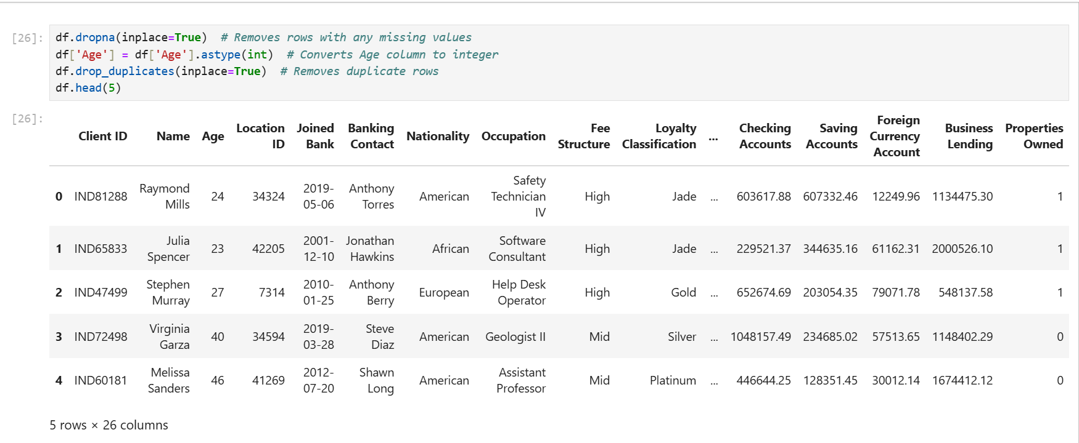
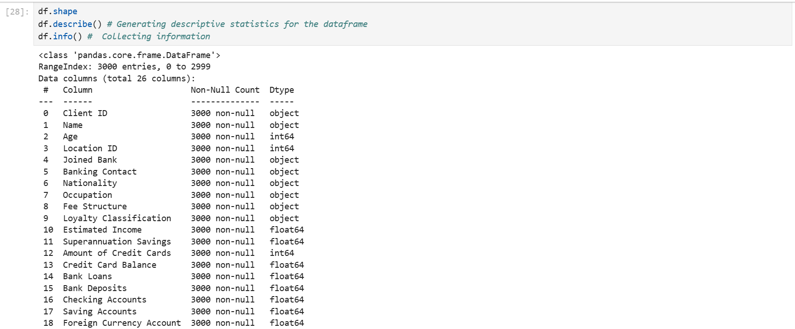
Preparing Data

Slide 8
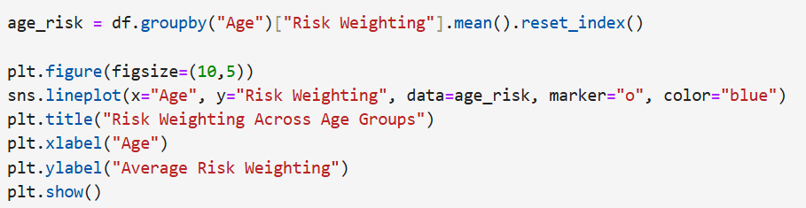
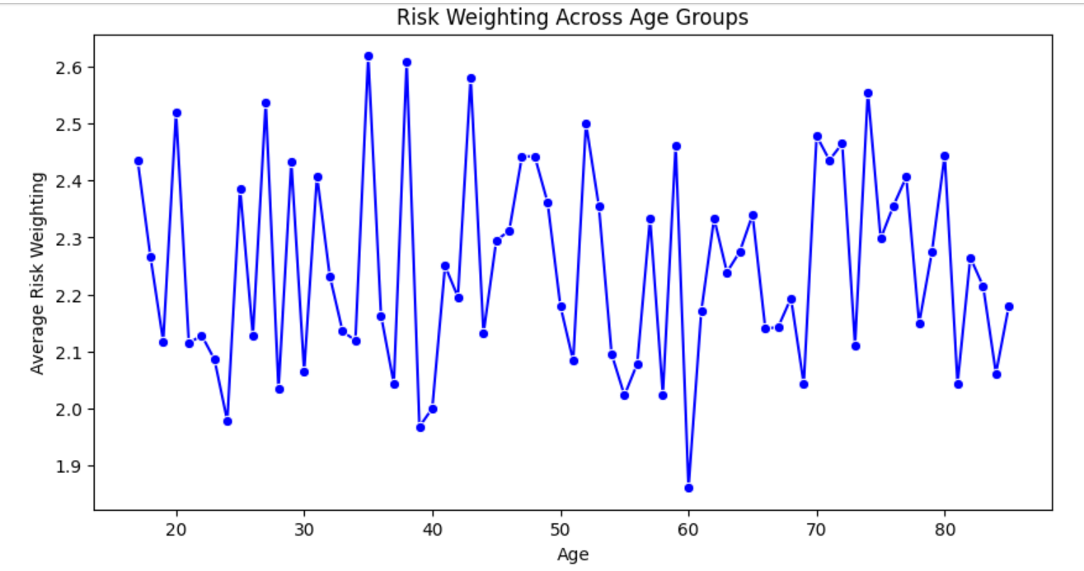
Question :- How does risk weighting vary with age groups ?
Answer :-
Result :-

Slide 9
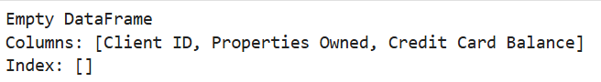
Question :- Which customers own multiple properties and have a high credit card balance ?
Answer :-
Result :-

Slide 10
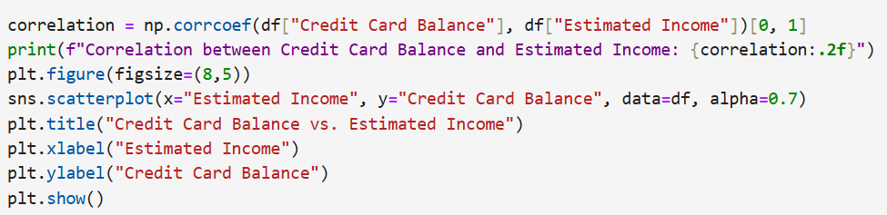
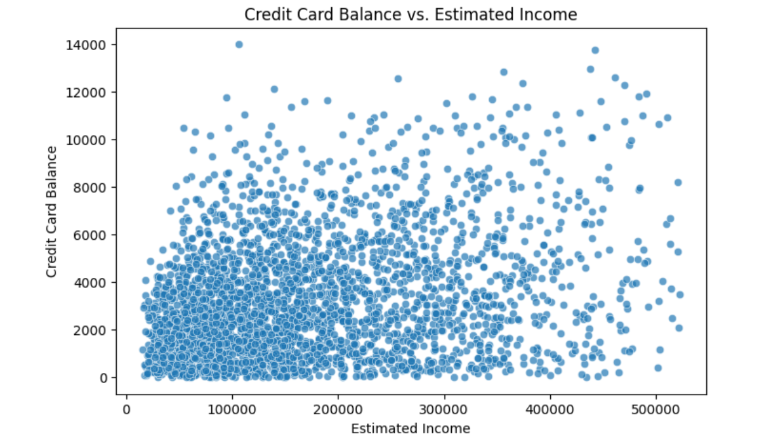
Question :- What correlation exists between credit card balance and estimated income ?
Answer :-
Result :-

Slide 11
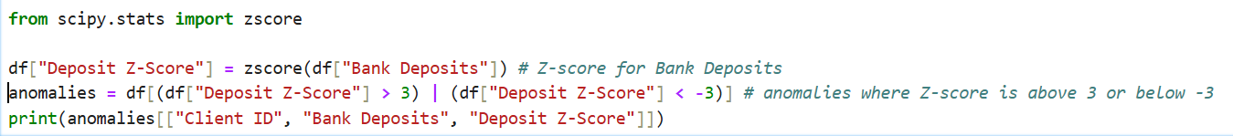
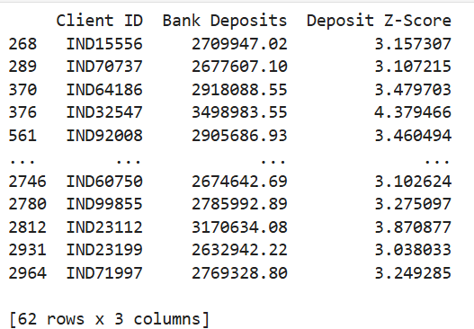
Question :- Detect anomalies in customers' bank deposits using statistical methods.
Answer :-
Result :-

Slide 12
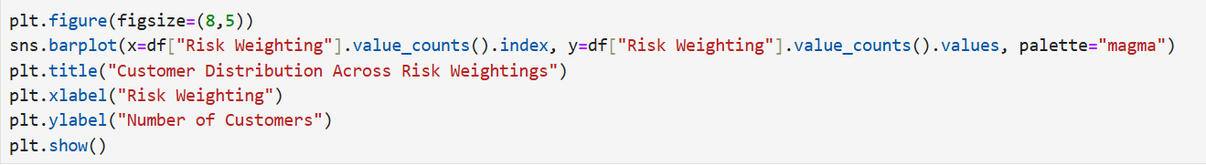
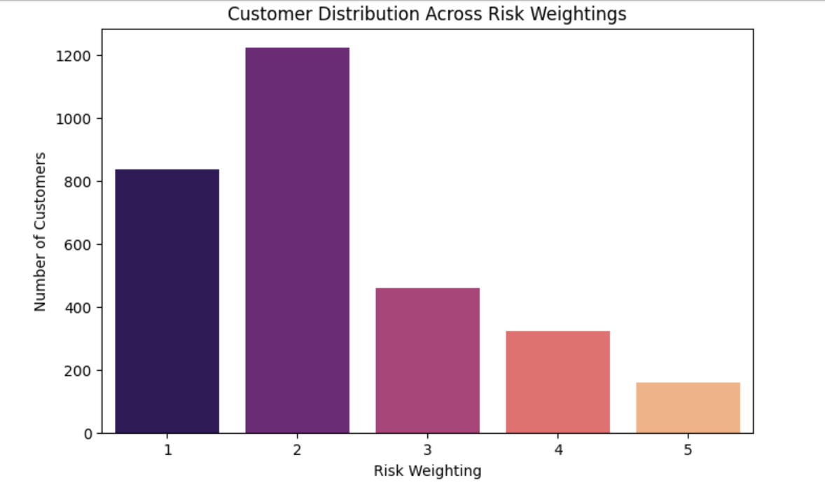
Question :- Visualize customer distribution across different risk weightings using a bar chart.
Answer :-
Result :-

Slide 13
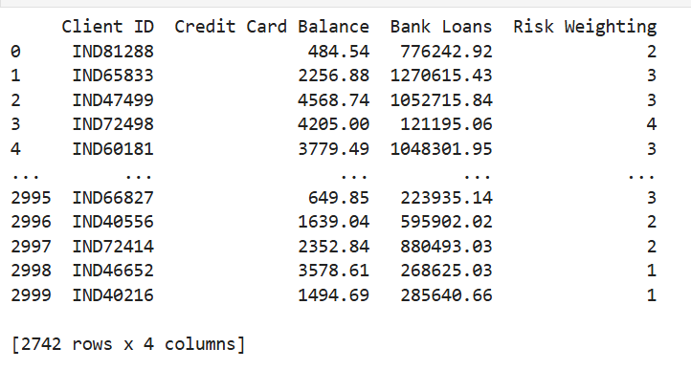
Question :- Detect potential high-risk customers based on their financial behavior.
Answer :-
Result :-

Slide 14
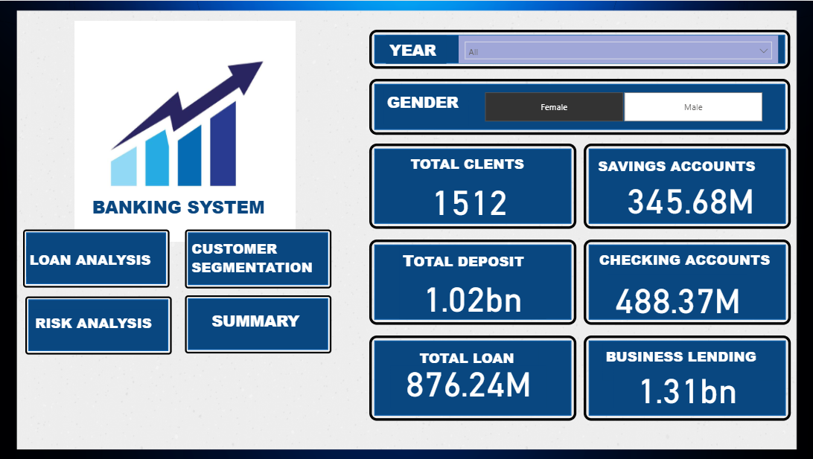
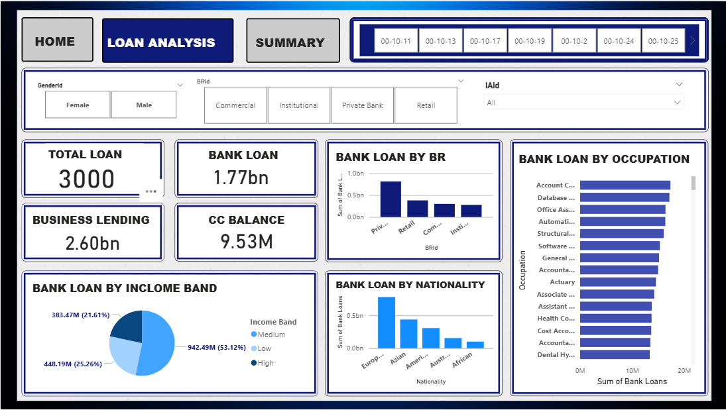
POWER BI DASHBOARD

Slide 15
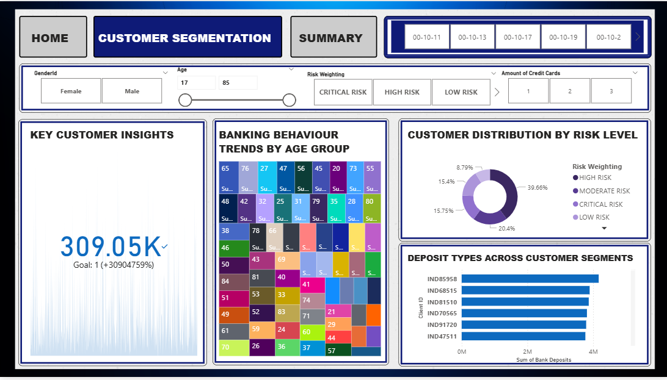
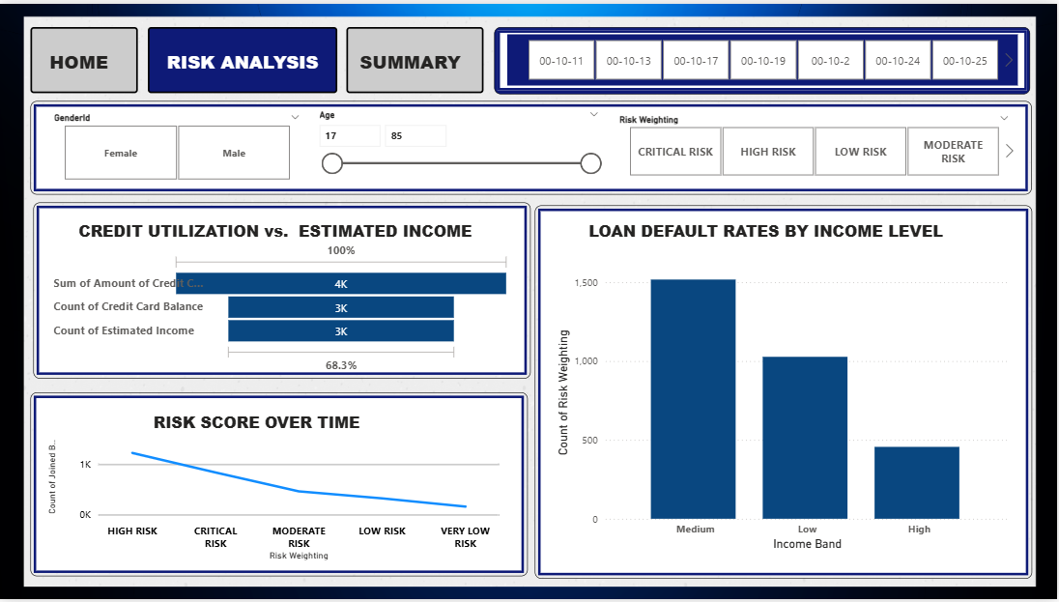
CONTINUE..

Slide 16
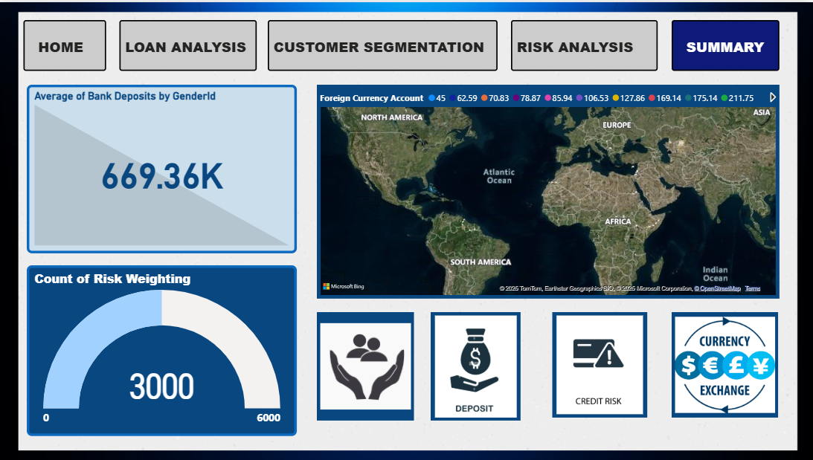
CONTINUE..

Slide 17

CHALLENGES
1
2
3
4
Data Cleaning Complexity
(Handling missing or inconsistent data)
Feature Selection Issues
(Identifying relevant financial attributes)
SQL Query Optimization
(Efficient data retrieval and aggregation)
Visualization Refinements
(Efficient data retrieval and aggregation)

Slide 18

INSIGHTS
Deposits and Savings Behavior :-
Bank Deposits and Savings Accounts show a strong correlation, suggesting that customers who actively deposit funds also maintain higher savings balances.
Income, Age, and Accumulation :-
Older individuals and higher-income earners tend to accumulate more in Superannuation, Savings, and Checking Accounts, reflecting typical financial lifecycle trends.
Low Correlation with Properties Owned :-
Property ownership depends on external factors like location or inheritance, leading to weaker correlations with banking metrics.
Business vs. Personal Banking :-
Business Lending correlates moderately with Bank Loans, indicating some overlap between personal and business debt, but remains largely independent of deposits or property-related metrics.

Slide 19
THANKS

